Slide 1
Daily Peer Massage Routine

Slide 2

Massage Rules
Always Ask for permission
Avoid touching the spine
Listen to your partner
Say thank you

Slide 3
Daily Massage Routine
Ask permission to touch your partner

Slide 4
Breathing
Hands on shoulders, breathe in through your nose, out through your mouth x 3

Slide 5
eye glasses x 3
Make three circles around the shoulder blades.
Stroke out to the arms and hold

Slide 6
climbing down a rope x 3
Have partner put one arm back . Place one hand just under the arm pit. Press firmly yet gently and ‘climb’, hand over hand, down the arm to the hand.

Slide 7
hearts x 3
Begin at the top of the back, with one hand either side of the spine.
Move the hands out and then downwards making a small heart- shaped formation, and coming back down to the base of the spine. Continue making larger and larger heart shaped formations.

Slide 8
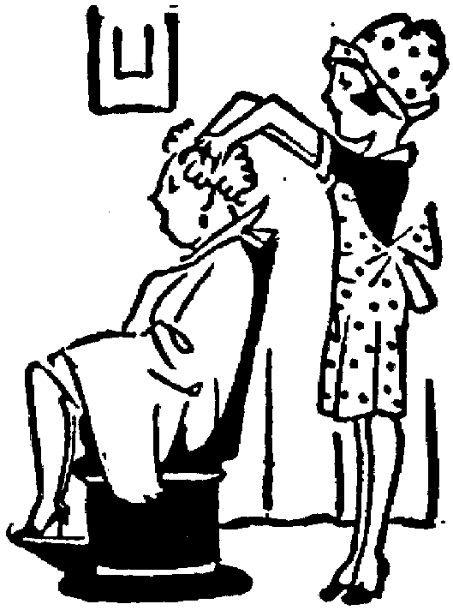
Hairdresser
Place fingers on top of hair, make circles with fingertips.

Slide 9
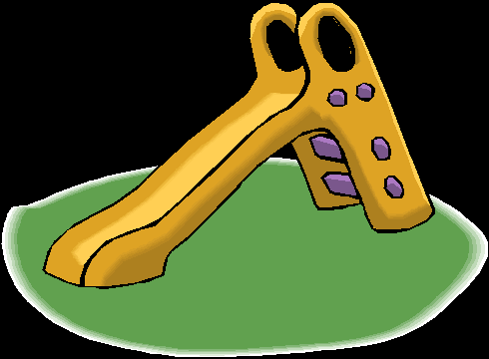
sliding board x 3
Stroke from thetop of the head down the neck and over the shoulders.

Slide 10
butterfly x 3
Hands on the middle of the back. With one hand cross over diagonally to the opposite shoulder. Give a little press and bring hand back to the beginning. Repeat with the other hand.

Slide 11
bear walk x 3
Place hands on either side of the spine, almost at the bottom of the spine. Press one hand after the other ‘walk’ up the back.

Slide 12
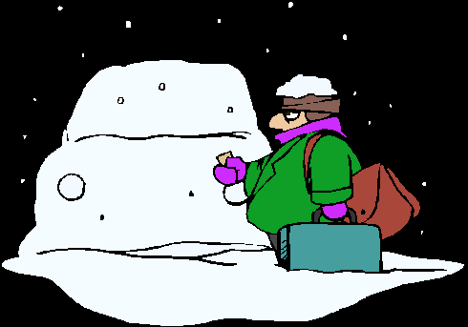
brushing off the snow x3
Stroke rather quickly out from the head, down the neck and over the shoulders.

Slide 13
forehead stroke x 3
Place the fingers on the forehead and stroke around to the side. Hold the head for a couple of seconds.

Slide 14
Breathing
Hands on shoulders, breathe in through your nose, out through your mouth x 3

Slide 15
Everyone say
‘thank you’
to each other. Now swap places with your partner.

