Slide 1


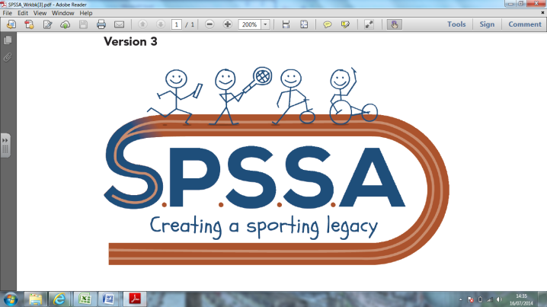

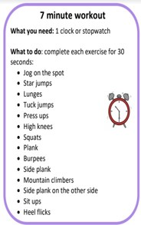
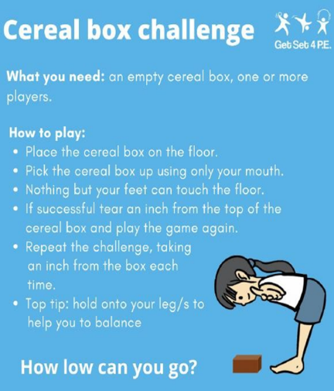
SPSSA Daily Challenges
Week 11
@SouthendWestSSP
@SouthendSSP
It is important to keep up a daily routine that includes physical activity and target the governments recommend 60 active minutes a day of exercise. We have collated a list of 7 days of fitness to keep you inspired and give you some ideas of what you can do at home.
Throwing and aiming to hit a target.
You will need a ball and masking tape/chalk to create a square target on a wall. Using 3 different throwing techniques to hit a target. Mark out 3 different distances to aim from. 1= close, 2= a bit further away 3= furthest
1, Under arm throw,
2. Bounce the ball down to bounce on the floor and hit the target
3. Over arm throws from a further away distance/
Can you?
In a safe space can you follow and copy these instructions
Can you…complete all of these for 60 seconds.
Jog on the spot.
Jog on the spot and punch your hands up to the sky.
Jog on the spot and punch your hands out in front of you.
Jog on the spot and punch your hands down to the side of your body.
Jog on the spot and make arm circles.
Make up your own routine and teach it to someone.
Throw Golf
Using a tennis ball or rolled up socks. Some objects to use as hazards & obstructions and a target a spot or bucket. Design your golf course to fit in the area you have.
Set a target number of throws that you have to get your ball into the hole, this is your par score.
To make it more realistic you can add a ‘water features’ (eg a blue towel), if you land in the water you have to take that shot again but the previous throw counts on your total.
The yellow rectangles are a bunker, you can land here but it will cost you an extra shot on your total.
Tee -Starting point
Don’t forget to share your photos of you staying active at home we love to see what you are getting up to.
Hole – target

