Slide 1






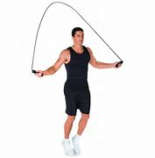

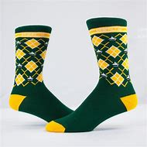
SPSSA Daily Challenges
Week 10
@SouthendWestSSP
@SouthendSSP
It is important to keep up a daily routine that includes physical activity and target the governments recommend 60 active minutes a day of exercise. We have collated a list of 7 days of fitness to keep you inspired and give you some ideas of what you can do at home.
Disney Dance-Along
Try a Disney dance routine, learn the moves to some of your favourite songs. Can you learn the moves and then teach a family member?
https://www.thisgirlcan.co.uk/activities/disney-workouts/
The speed stacking challenge
The challenge is a fun way to improve your hand eye coordination.
The aim is too smoothly stack a pyramid of cups without knocking them over, and then dismantle your pyramid with no disasters
https://www.bbc.co.uk/programmes/articles/5K6QMDpwmHQK999DtmvhGgG/the-speed-stacking-challenge-makeyourmove
Catching
You will need 10 pairs of socks/balls a bucket/box and a partner.
Catcher places the bucket down 5 steps away from thrower as a target. Thrower throws the socks to the catcher, the catcher has to catch as many pairs of socks as they can out of ten. Place them into the bucket when caught to be counted at the end. https://youtu.be/jZBpToP6hYo
Scavenger Hunt
Can you find objects or things that make letters in your First name. You may find them around the home or outside.
Eg a Lamppost that makes an I, a ball for the letter O.
Be creative, look at details within objects, you may find letters inside them eg a doorkey hole makes the letter i.
Sock wars
An adapted game to tag rugby, find some socks to tuck in your waist band.
Can you protect your socks from capture by an opponent.
Can you capture socks from your opponent.
What could you do to prevent them from stealing your socks?
Skipping Challenge
Test yourself to see how you get on skipping for a minute using some different foot patterns.
https://www.bbc.co.uk/programmes/articles/1pvJl3dLyswVpWwq6bkGGqP/the-skipping-challenge-makeyourmove
Head, Shoulder, knees, toes catch
You will need a pair of rolled up socks or a tennis ball.
Throw the ball up in the air and see how many parts of the body can you touch before catching the ball starting with your head.
Call out the body parts as you touch them.

