Slide 1
Essex Steps
Parent Workshop
Developing a therapeutic approach to behaviour

Slide 3
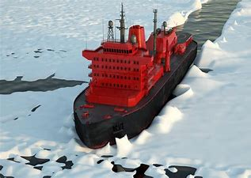
2 Minute Icebreaker
Think of one thing that you would like to change about your child
Think of one thing your child would like to change about you

Slide 4
Therapeutic?
Essex Steps defines therapeutic as:
An approach to behaviour that prioritises the pro-social feelings of everyone within the dynamic.

Slide 5
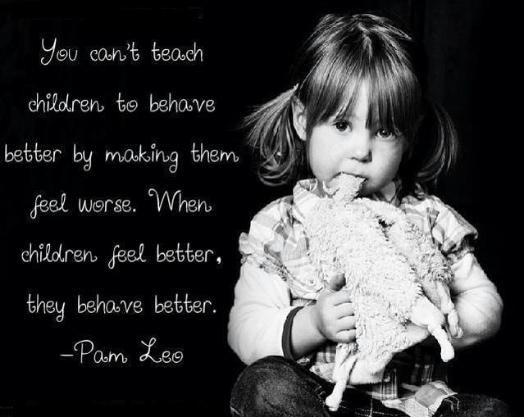


Slide 6

Name it to Tame it!
By naming emotions and feelings, we stimulate the thinking part of our brain which stimulates the vagus nerve and calms our bodily responses
Professor Dan Siegel - The Whole-Brain Child
Notes:
The Vagus Nerve reaches all parts of the human body. It can be thought of as a major mind-body highway.
Through the Vagus Nerve, you react to signals in your environment in ways that calm, alarm, or dysregulate the body. These then create emotional experiences which can be reflected in behaviour.
This is one of the many important reasons we teach/model/co-regulate emotions and feelings to our young people.

Slide 7
Which pro-social feelings do we want to create in our children and families?
Which anti-social feelings do we want to protect our children and families from experiencing?

Pro-social feelings
Liked | Loved | Respected
Involved | Included | Comfortable
Motivated | Safe | Encouraged
Able | Brave | Curious
Capable | Valued | Secure
Relaxed | Hopeful | Optimistic
Calm | Trusting | Determined
Tolerant | Needed | Kind
Inquisitive | Happy | Absorbed
Playful | Proud | Enthusiastic
Supported | Wanted | Understood
Anti-social feelings
Angry | Sad | Alone
Worried | Lonely | Misunderstood
Cautious | Anxious | Embattled
Shamed | Blamed | Criticised
Hopeless | Scared | Withdrawn
Depressed | Fearful | Panicked
Naughty | Hurt | Ashamed
Reluctant | Judged | Powerless
Hopeless | Useless | Humiliated
Defiant | Tearful | Aggressive
Excluded | Unsure | Frustrated

Slide 8
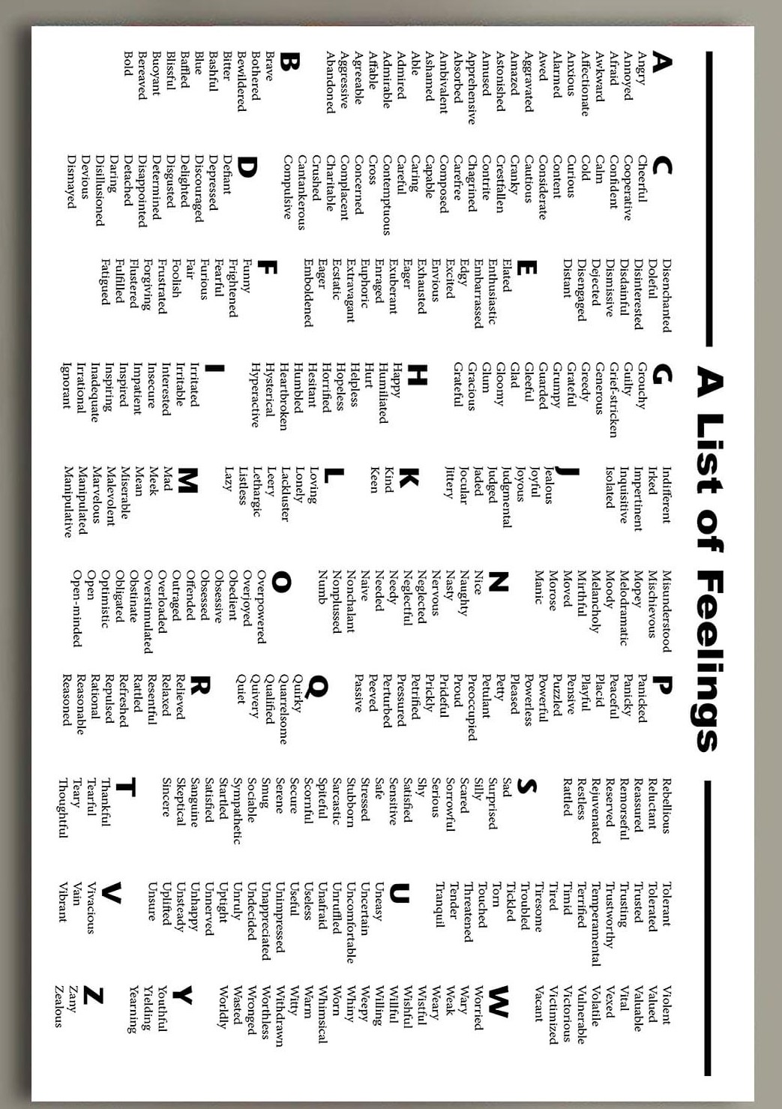


Slide 9

Let’s talk about discipline!
What is discipline?
What do you think of when you see the word discipline?
Negativity or Positivity?

Slide 10
Discipline definitions
External Discipline (Controlling Behaviour)
Training people to obey rules or a code of behaviour, using punishment to correct disobedience. (noun, also known as external discipline)
Internal Discipline (Teaching Behaviour)
Train oneself to do something in a controlled and habitual way. (verb, also known as internal discipline)

Slide 11

To create change we need to understand, not simply suppress, the behaviour.

Slide 12
How can we control behaviour?
Dominating and imposing
Demanding obedience
Telling them what they must not do
Punishing them
Bribery
Taking away all pleasurable experiences
By shaming, belittling, embarrassing, and humiliating
The focus here, is based around controlling your child’s behaviour. This leads to short-term change at best.
The rule about behaviour becomes more important than the reason behind the behaviour.

Slide 13

Dr Bruce Perry’s Model
(Neurosequential Modelling)
Regulate – Get your child regulated first. Calm their survival response. Examples may be: Play, Food, Rest, Music, Creative Activities, Movement, Quiet Safe Spaces.
Relate – Connection! What’s your relationship like with them? Children don’t care what we know until they know that we care! Connect with them through: Empathy, compassion, listening, tone of voice, body language.
The order in which our children process information is firstly, our tone of voice, secondly, our body language and facial expression, then finally our words. In that order!
3. Reason – Once they’re regulated, calm and connected, then they may be ready to reason with us. To be able to reflect, to learn and to engage and to solve problems. To reason.

Slide 14
How can we teach behaviour?
Relationships
Role modelling the behaviour we want to see
Being consistent in our approach
Scripts and routines
Putting the emphasis on what we want to see, NOT what we don’t.
Planning – doing something different to meet their needs
Positive reinforcement - catch them getting it right
Feedback and recognition – eg telling them how you felt and others too!
Comfort and forgiveness – really forgiving them for something they did
And this is how we get long term change. Always ask the question, ‘What does my child need to learn and how am I going to teach them?

Slide 15
The move from external discipline to internal discipline is the journey from child to adult. We all need to help young people on this journey.
Angela Wadham 2009

Slide 16
Internal Discipline
0% 50% 100%
EY
Primary
Secondary
FE
Life

Slide 17
Who needs to learn?
If you’ve told a child a thousand times and she still does not understand, then it is not the child who is the slow learner
Walter Barbee

Slide 18
Behaviour analysis
Analyse not moralise
Notes:
Lets try to understand rather than make a judgement on our child’s behaviour. Be interested in the Why?
Is their behaviour PREDOMINANTLY conscious or subconscious? Is it due to being overwhelmed, dysregulated and out of control or is it predominantly about choice. Its usually not 100% conscious or subconscious but what we need to ask is whether we need to change or whether the child needs to change.

Slide 19
Subconscious Behaviour
This is when our child is unable to moderate or self-regulate
or
Conscious Behaviour
This is when our child is unwilling to moderate or self-regulate
*

Slide 20
Conscious and subconscious
The degree to which our child is planning and choosing a behaviour because of perceived gain/outcome
100%
Conscious
100%
Subconscious
The degree to which our child’s behaviour is an unplanned reaction to an overwhelming experience or feeling
Notes:
20

Slide 21
Function of behaviour
All behaviour has a function.
Function is what the behaviour is communicating.
One behaviour may have more than one function.

Slide 22
Function of Behaviour
Why is your child’s behaviour occurring?
Questions to consider. Is the behaviour………
Sensory - Is it meeting a known or unknown need? touch/sight/sound etc
Escape/Avoidance - Avoiding, delaying or withdrawing from tasks, activities, demands, certain environments, attention, people
Attention - The behaviour appears to be searching for interaction or reaction, connection-seeking
Tangible - To get something or someone as a result of the behaviour


Slide 23

Anxiety
A mild or severe feeling of unease, worry or fear.
Everyone has feelings of anxiety at some point in their life. You may feel worried and anxious about an exam or having a medical test or job interview. During times like these, feeling anxious can be perfectly normal.
*Some people find it hard to control their worries. Their feelings of anxiety are more constant and can often affect their daily life. (NHS Inform)

Slide 24
When this goes beyond what they can manage, there may be times/things/people that they:
Can’t Cope With
Or
Can’t Cope Without

Slide 25
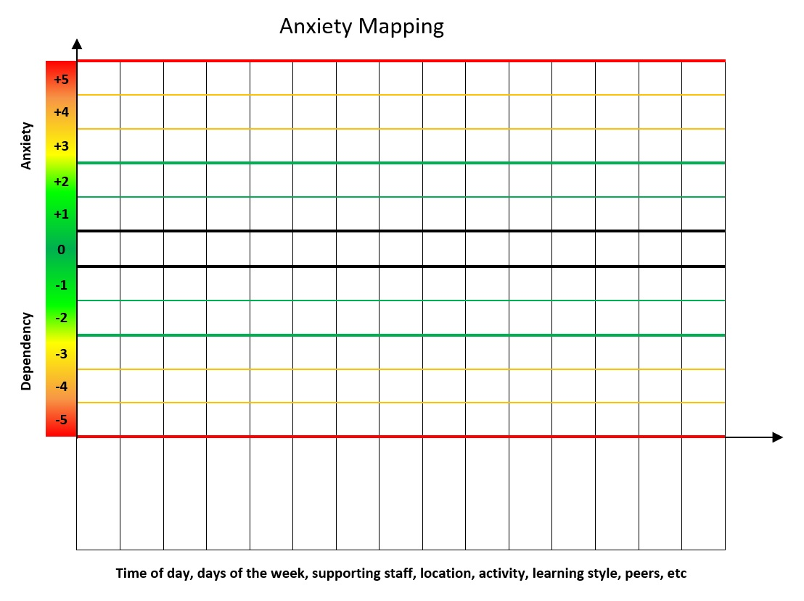
Dangerous behaviour
Difficult behaviour
(affecting others)
Difficult behaviour
(affecting self)
Limit of self management
Comfortable self management
Neutral
Comfortable self management
Limit of self management
Difficult behaviour
(affecting self)
Difficult behaviour (affecting others)
Dangerous behaviours
Cannot cope with
Does not like but can cope
Likes but can cope without
Cannot cope without
Notes:
Anxiety is about considering WHAT YOU CANT COPE WITH.
Dependency is about considering WHAT YOU CANT COPE WITHOUT.

Slide 26
Anxiety Analysis
+5
+4
8.30
9.00
9.30
10.00
10.30
11.00
11.30
12.00
12.30
1.00
1.30
2.00
2.30
3.00
3.30
+3
+2
+1
Dependency Anxiety
0
-1
-2
-3
-4
-5

Slide 27
*
So what do we do?
How do we respond?

Slide 28
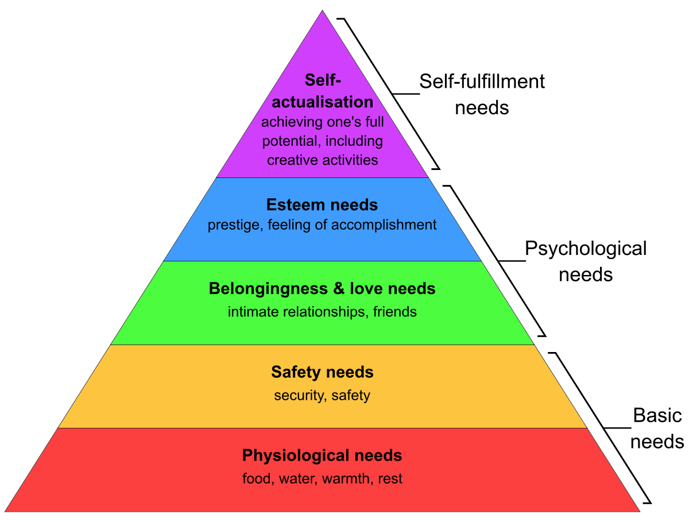
First things first………
Maslow’s ‘Hierarchy of Need’

Slide 29
Is my child……
Hungry?
Angry?
Lonely?
Tired?
HALT!

Slide 30

Mind Your Language
Notes:
The language we use with our children can be so useful to de-escalate (or escalate!) a situation……

Slide 31

Faced with your child in crisis, what could we say to make it worse?
Notes:
31

Slide 32

Language activity
Negative phrasing
No choice or open choice
Empowering behaviour
Escalating Scripts

Slide 33
Negative phrasing
Calm down
Stop being silly
Be good
Don’t throw the pencil
Stop running
Don’t talk to me like that
They don’t hear an instruction telling them what to do instead.

Slide 34
Making demands
Get in here now!
Get out!
Do as you are told!
Give it to me now!
Open choice
What do you want to do?
Would you like to go inside?

Slide 35

Empowering the behaviour
Come back here, NOW
You are not allowed in there
Get down from there
Don’t you dare swear at me

Slide 36

Avoid Saying "NO" and "Don't"
It doesn't tell your child what behaviour you want to see. Therefore, it’s not helpful.
Children hear the action word in your statement. Telling your child "Don’t ****" will guarantee that s/he will immediately want to ****.

Slide 37
Sometimes we promote the behaviour we want our child to stop:
"STOP YELLING!!", "NO HITTING!" Expect the wrong message to be heard by our child. Yelling at children CREATES yellers. Hitting our children teaches them that hitting is not just acceptable but necessary.

Slide 38
Avoid Lecturing/Nagging/Moaning
Most children switch off after 8 or so seconds (if you’re lucky!). So try to make your message clear and succinct
(Dr Philippa Perry, ‘The Book You Wish Your Parents Had Read’ 2020)

Slide 39
Language activity
Positive phrasing
Limited choice
Disempowering the behaviour
De-escalating scripts


Slide 40
Positive phrasing
Stand next to me
Put the pen on the table
Walk in the corridor
Switch the computer screen off
Walk with me to the kitchen
Stay seated in your chair
Actually tell your child what you want them to do
Describe the behaviour you want to see!
Put the ‘oxygen’ into the behaviour you want to see.

Slide 41
Limited choice
Where shall we talk, here or in the kitchen?
Put the pen on the table or in the box
I am making a drink, orange or lemon?
Are you going to sit on the chair or the sofa?
Are you starting your homework with words or a picture?

Slide 42

Disempowering the behaviour
You can listen from there
Come and find me when you come back
Come back when you are ready.
We will carry on when you are ready.

Slide 43
THANKS
Try saying “thanks” not “please”. You might really need your child to do something.
“Thanks” assumes it will be done but also adds courtesy.

Slide 44
Riding the wave
Dangerous Behaviour
Familiar comfortable behaviour
Escalation
Catch them getting it right

Slide 45
Punishment
or
Consequence

Slide 46
Friedrich Nietzche (1844-1900)
Punishment hardens and numbs. It produces obstinacy, it sharpens the sense of alienation and strengthens the power of resistance.
A
S

Slide 47
Consequences
A conclusion derived through logic
Something that logically or naturally follows from an action

Slide 48
Protective consequences:
Removal of a freedom to manage harm
But these must also involve learning through….
The learning, rehearsing or teaching so the freedom can be returned
Educational consequences:

Slide 49
If harm has happened, somebody has been hurt or something has been damaged/broken then consider a Protective Consequence before an Educational Consequence.

Slide 50
Protective consequences
Increased supervision in play, being outside
Limited access to a space where the harm happened.
Escorted in social situations
No availability of a car (eg if they won’t wear a seatbelt or behave dangerously in it)
Adapted spaces for your child to be in

Slide 51
Educational consequences
Completing tasks
Rehearsing
Assisting with repairs
Educational opportunities
Research
Conversation and exploration

Slide 52
Testing consequences
Think of some of your commonly used responses to behaviour
Link the response to the behaviour with the word obviously
If it makes sense you probably have a consequence. If it lacks sense it is probably a punishment.
You didn't take the dog for a walk so, OBVIOUSLY, you can't go swimming?
You refused to get out of the pool last week and we were all late back so, OBVIOUSLY, you can't go to the pool until we are confident you will get out when asked.

Slide 53
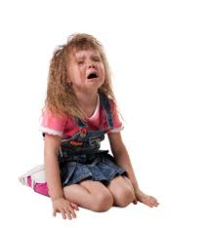
De-escalation phrases

Slide 54
De-escalation Phrases
Say their name
I can see something’s happened
I am here to help
Talk and I’ll listen
Come with me and…………

Slide 55
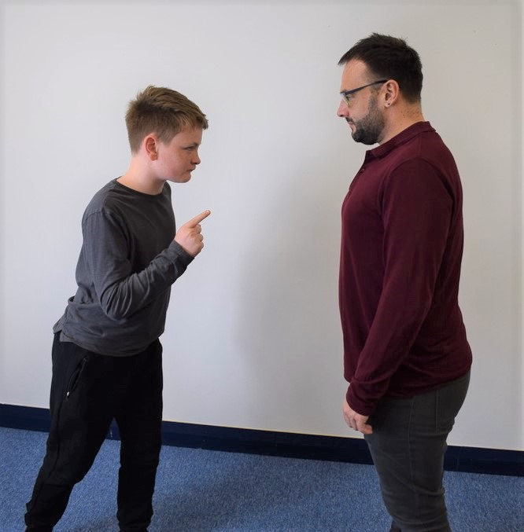
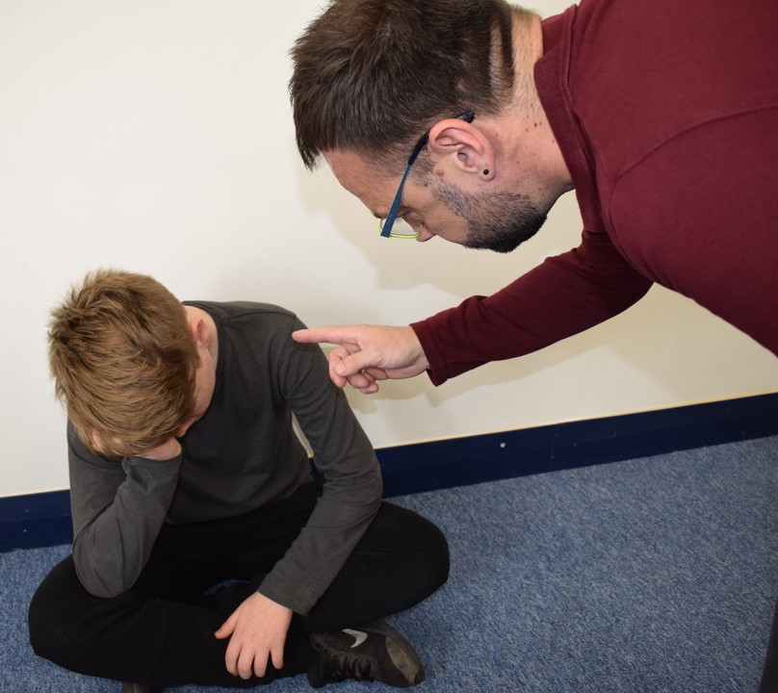
Escalating body language

Slide 56
Escalating Body Language
Inside of an outstretched arm
Too close
Toe to toe, eye to eye
Blocking the path
Aggressive gestures
Over-bearing

Slide 57
De-escalating body language
Outside of an outstretched arm
Good distance
Sideways stance
Leaving an open door
Relaxed hands
Managing height

Slide 58
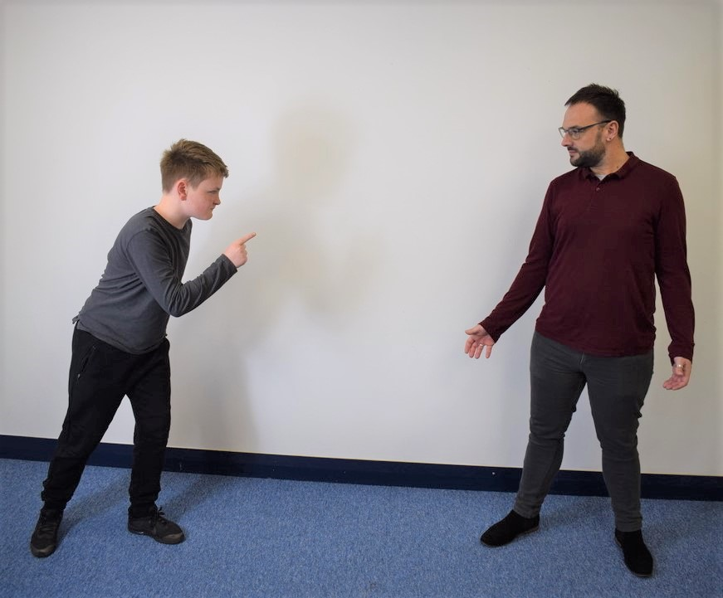
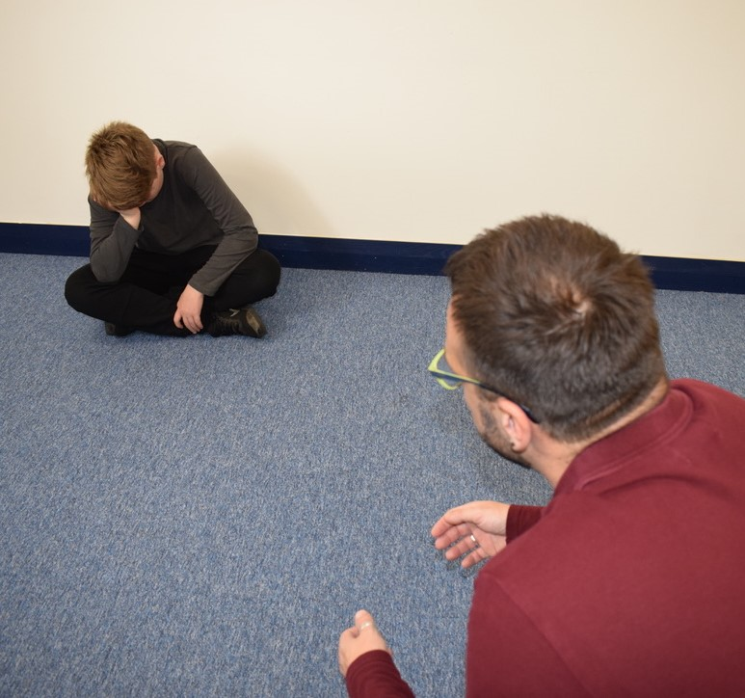
De-escalating body language

Slide 59
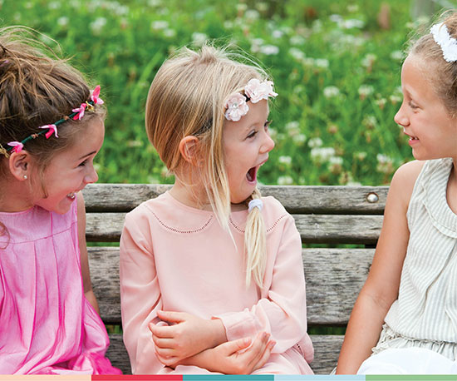
Reflect, repair and restore

Slide 60
If it helps, think of PACE when you are talking to your child……..
P for Playfulness
A for Acceptance
C for Curiosity
E for Empathy
Developed by the Clinical psychologist Dan Hughes, the PACE model helps parents/carers form secure attachments with the child and build a safe space for open communication. This creates the ideal environment for positive behaviour change.

Slide 61
More simply it involves asking:
Explore what happened? (tell the story)
Explore what people were thinking and feeling at the time?
Explore who has been affected and how?
Explore how we can repair relationships?
Summarise what we have learnt so we are able to respond differently next time.

Slide 62
Restorative questions
What would you like to happen next?
How can we make things better for Billy / you?
If everything was going to be alright, what would need to happen?
How can you help to put this right?
How can we make it OK for you to go back to school / bed etc?
What do you think Billy might need?

Slide 63
Additional differentiated approaches
Social stories
Comic Strip Conversations
Role-play with dolls/soft toys or puppets
Circle time activities
Signing or signalling
Use signs, pictures and symbols to communicate emotions
Complete a ‘Roots and Fruits’ tree

Slide 64

Further optional reading:
The Book You Wish Your Parents Had Read by Philippa Perry
What Happened to You by Dr Bruce Perry and Oprah Winfrey
Love Matters by Sue Gerhardt
Raising Boys in the 21st Century by Steve Biddulph

Slide 65

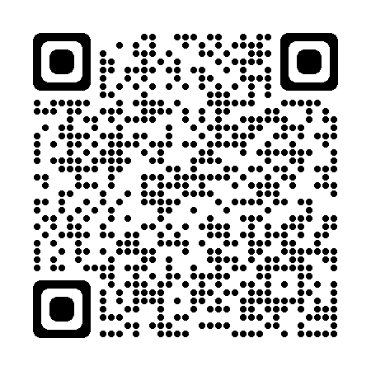
Evaluation
Name one thing you have learned today
Please point your phone camera at this QR code which will take you to an evaluation form. We would really appreciate your feedback. My name is Joel Shaljean for the record!

Slide 66
For further information
Joel Shaljean Essex Steps Lead
07872 865656 joel.shaljean@esset.org.uk
SBM Services Essex Steps Admin essexsteps@esset.org.uk

