Slide 1
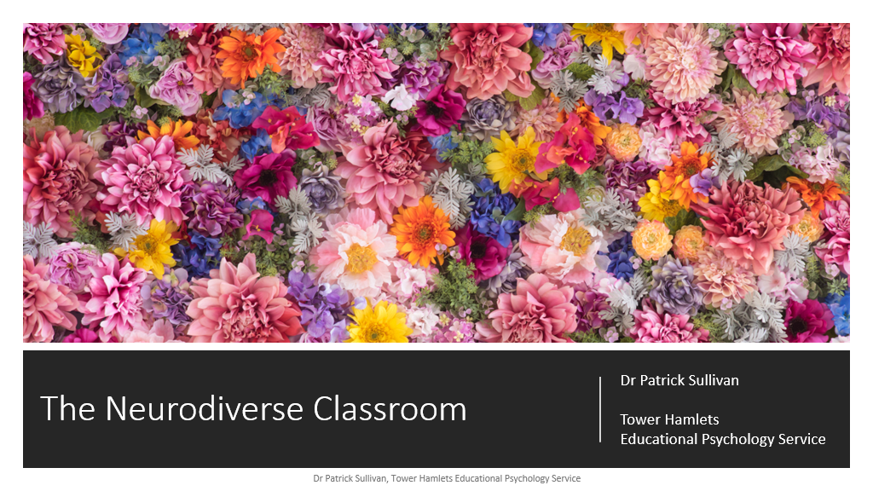
The Neurodiverse child
Kerri White – SENCO
EPS – Christina Joint
Think about what you do to support YOUR own wellbeing?

Slide 2
We do Zones of Regulation – the size of the problem is really getting the children to understand.
They are fine in class – I have no worries about them, but their parents are saying different. Please help
I have a tent but the children who need it don’t always want to.
Some staff views over the last 6 weeks.
They have ear defenders, but they don’t like putting them on, we have used rewards, spoken to them, but still they won’t even with encouragement.
I have fidget toys, which work for the child, but they are disrupting the other children
I have a ‘now’ and ‘then’ board – this visual board is helping

Slide 3
Mrs Waite, always listens, especially if it’s a big problem
‘Worry box’ – ‘I don’t have one’ –
‘Yes we do!’
Mrs Wilson listens and helps me and my family
Pupil views- Who and are your views listened to?
What helps you in school to feel happy and safe?
My teacher – just a hug helps me
All the teachers – I’ve ever had…….
Everyone in this school will help
Mrs Allen and the LSAs always help us
Sydney the Snow Owl
The MDAs listen to me and try and help sort the problem or they tell my teacher
The panda room is great
We have a tent, quiet book area with bean bags.

Slide 4
What is your child doing, which is causing you to worry?

Slide 5
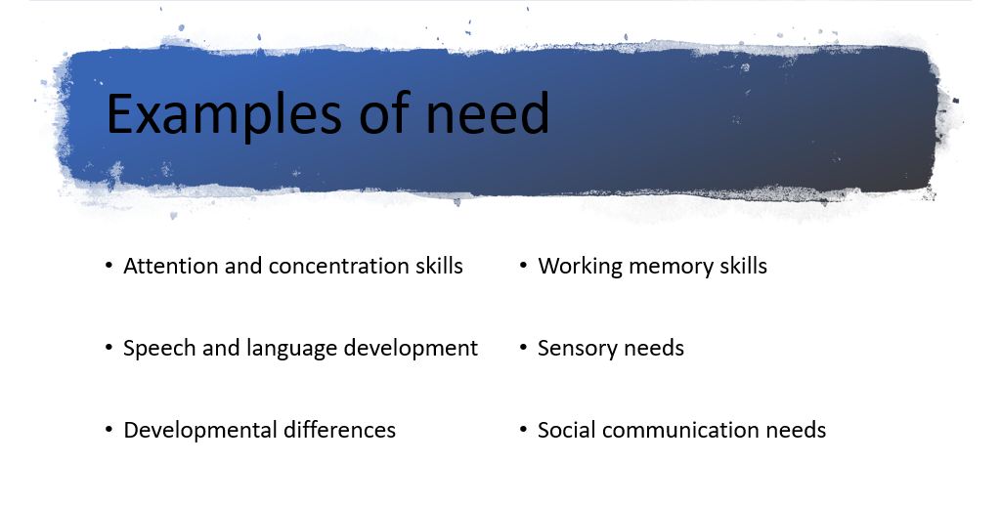
https://youtu.be/38ur_bxJJG4
https://vm.tiktok.com/ZMFBnbkDm/

Slide 6
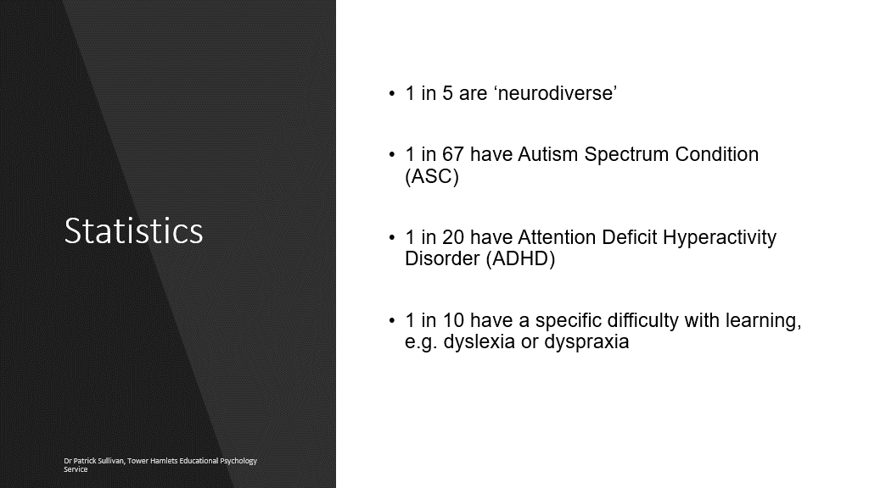
At least 5 of your pupils will have SEND needs

Slide 7
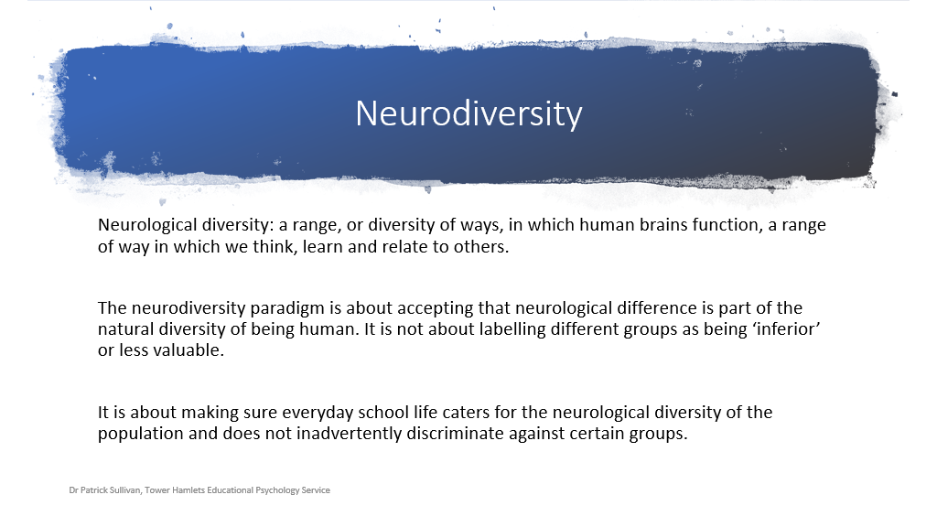
https://www.youtube.com/watch?v=7_LIC-9rEi0

Slide 8
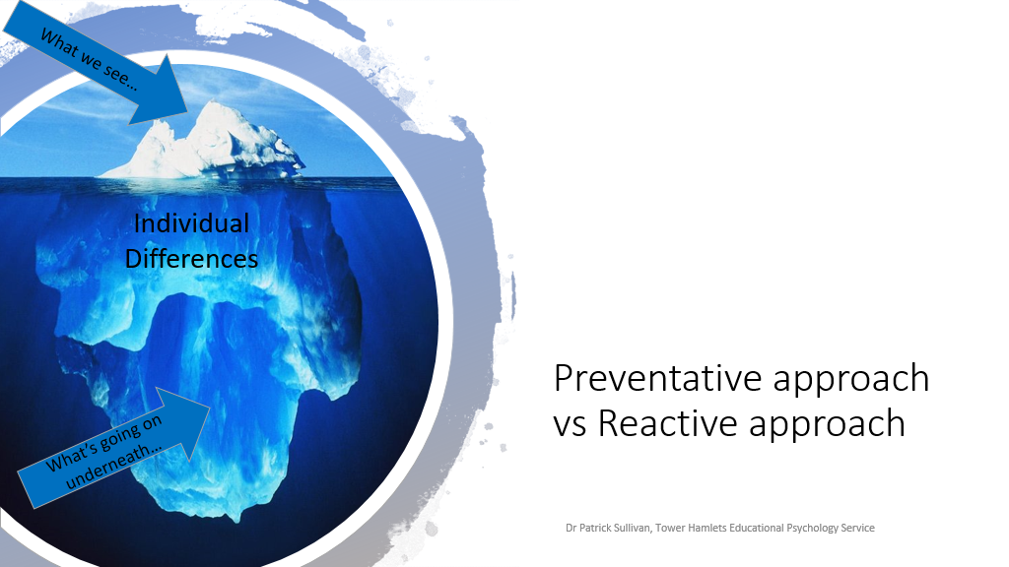
They are fine in class – I have no worries about them, but parents say different. We understand that many pupils will ‘mask’ their needs in school, but eventually from experience we know these are displayed in school.

Slide 9
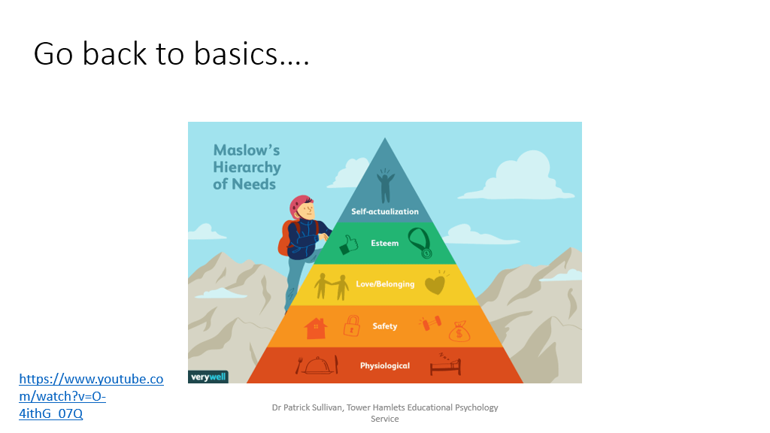

Slide 10
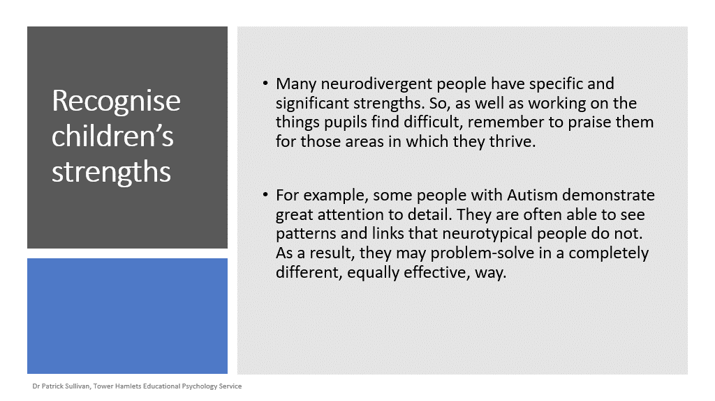

Slide 11
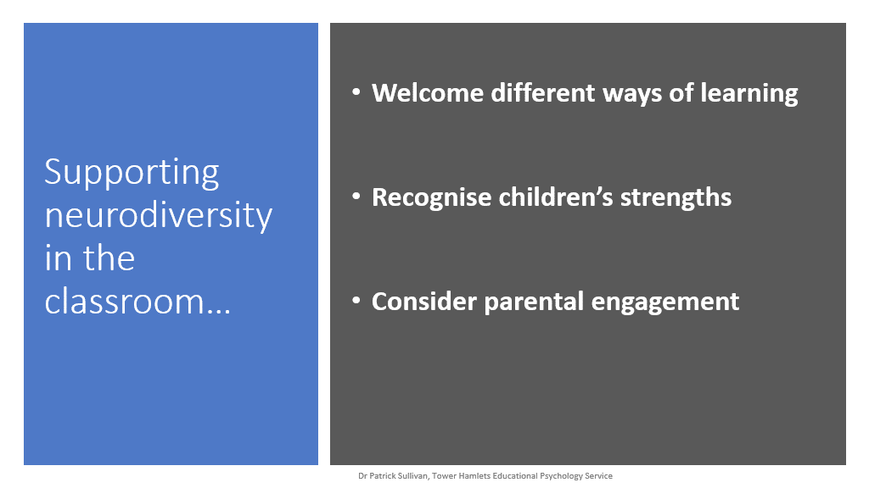
Support independence and resilience

Slide 12
Understanding neurodiversity at home?
Listen to their worries, do not respond by saying ‘don’t worry, or it will be okay’. Respond by saying I will give you some time to think about this, then we can find an answer together.
Take them back to a ‘good’ memory where they showed they could cope with what your asking them to do.
Do they have quality time with key people at home?
Do they have a good sleep, eating pattern?
Are you letting them take safe ‘risks’ or trying to protect them by not letting them be independent or resilient.
Is it affecting their everyday life in more than one environment?

Slide 13
Welcome different ways of learning
It can be challenging to know what comes naturally to neurodiverse children and what needs to be taught. Different sensory experiences impact the ability to take in information, or learning might not “go in” the way it is intended because of differences in social skills.
When standing in front of a neurodiverse child, Consider:
  Modifying your facial and language being used
  Adapting how much time you are given them
  When to check-in to see how a child is getting on, and when to take a step back and allow them to test what they have learned.
  Do they have a quiet, calm space at home.

Slide 14
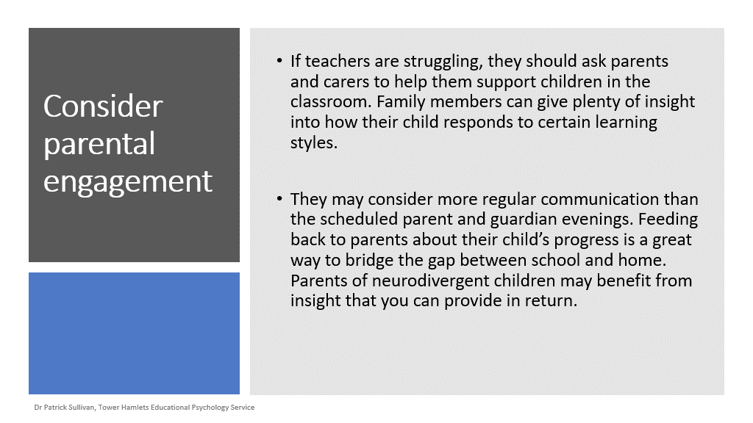

Slide 15
Support Independence and Resilience
It is important to recognise that building independence, confidence and resilience is key in meeting the needs of all children as they learn.
Asking questions that help the child to think about the ways they might approach a new experience and solving problems can be helpful. Over time, children are likely to become more confident asking themselves these questions independently.

Slide 16

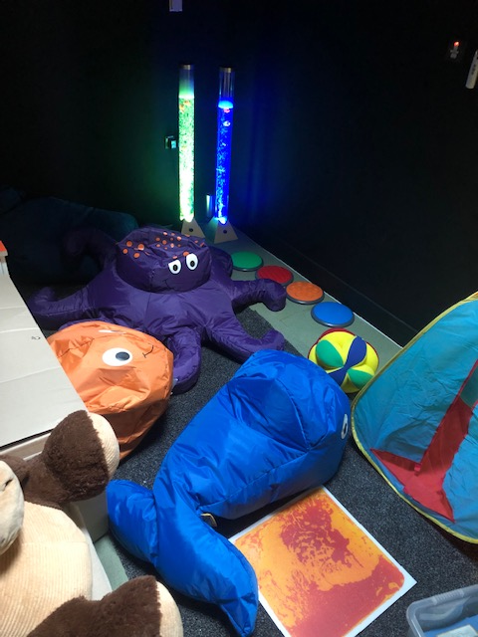
What do we have to offer at Hinguar?
Schools are the first point of reference for children who are suffering with mental health
problems – not health services!
The Offer we provide is for everyone -
The Panda Room is now ready and open. The room is fully equipped to support children
to be able to learn, to take time to self-regulate, to support their wellbeing and happiness.
Every classroom has their own sensory area, visual timetables and visual resources in daily activities.
Zones of Regulation resources and lessons should be taking place – regularly (the classes who use this, you hear children’s voice speak about the colours they feel, the size of the problem).
Sensory breaks such as – daily mile, five minute stretch, yoga break, attention and listening songs.
Fidgets – given directly to children by staff and zones of regulation monsters.
School-based early intervention supports available to all pupils who require help – daily nurture group every morning.
Specialist/trained staff – to take groups for loss, bereavement, friendship, and self esteem
Access to Specialist Tecahers, School Counsellors – both children and staff, Emotional Wellbeing and Mental Health Service (EWMHS), KIDSINSPIRE and specialist sports teacher

Slide 17
In what ways can we support neurodiverse children to have confidence in their learning skills?
Why is this important?
This morning I thought about a child who has possible Dyslexia?
What do we do in school already - What can we do
Interventions Speak to them first and the family
Precision Teaching what specific areas are they finding
Toe By Toe difficult – what could help them
Phonics
Coloured sheets More time – not missing play, but
Visual Prompts during assembly, during some input
Extra time in test
1:1 support ICT suite – teach them to type –
Daily Readers spell checker will do the rest.
Spell checkers

Slide 18
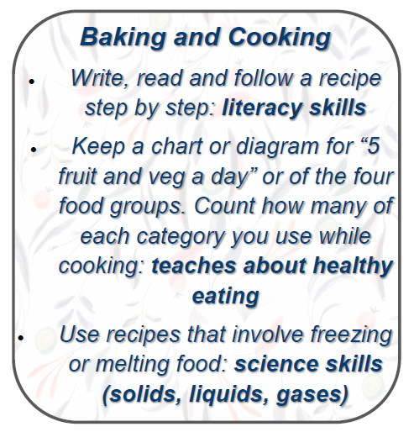
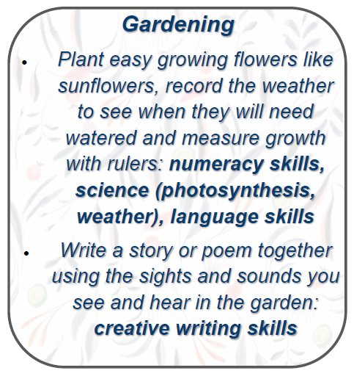
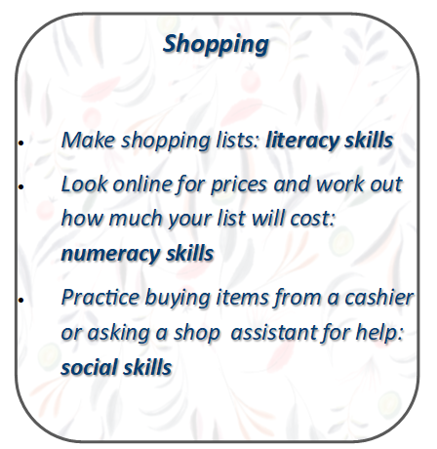
What next?
What are your child’s strengths – start from here
Keep a record of your worries and concerns – how often, when it takes place, triggers?
Speak to the school, they will be able to inform you if your child’s traits are affecting their learning or social interactions?
If the answer is yes, with school support refer to the GP for a lighthouse appointment.
Speak to the school – class teacher or pastoral team

Slide 19
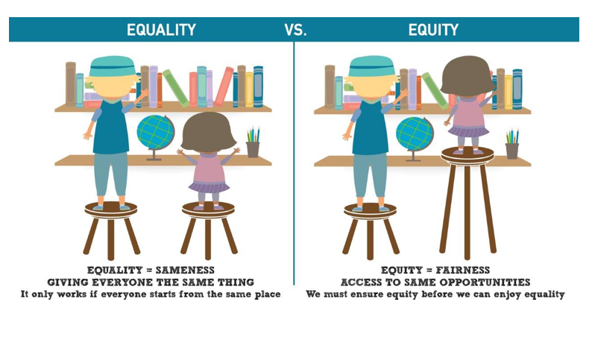

Slide 20
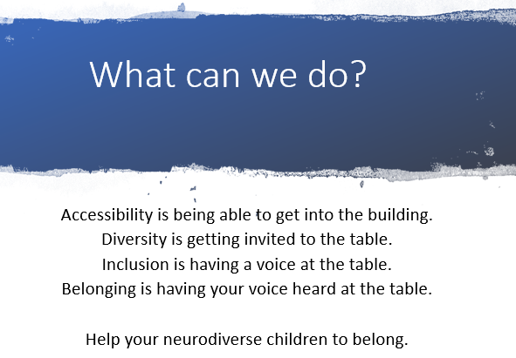

Slide 21

Homework please listen - Danny Gray: My Fight With Body Dysmorphia & Mental Health - YouTube
On a post it note – please write one thing you are going to try at home
On your own or with a partner discuss one thing you could try this half term to support YOUR own wellbeing, or something you would like to try to further support your wellbeing.

